Slide 1
final GROUP PROJECT PRESENTATION
BY ahsan, hamza, alex and Cameroon

Slide 2
introduction
Introducing everyone's roles
Why we chose a fingerprint lock?
Improvements made to the model
Conclusion
Notes:
Demand in biometric authentication. AND ensuring security is met when using our fingerprint print lock

Slide 3


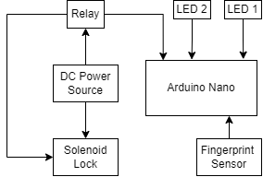
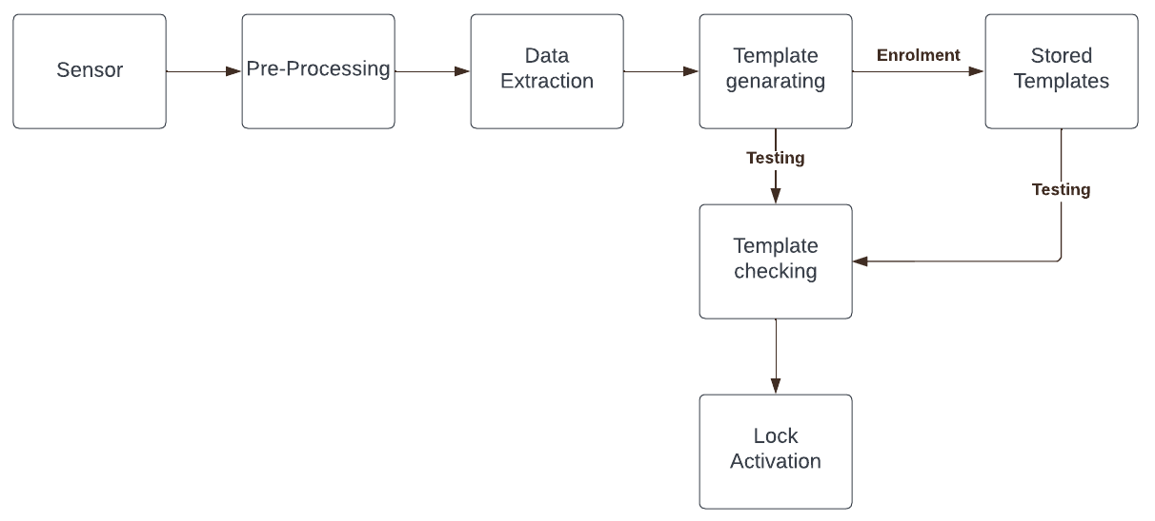
Block diagrams
Hardware
Software

Slide 4
improvements
CONVERTED BREADBOARD ONTO A PCB
POWERED BY A 9V BATTERY
CASE CREATED TO HOLD THE PROJECT
COMMERICALLY SUITED

Slide 5
Testing strategies
Checked each component using a Multimeter
Check voltage across each connection after soldering by using a Multimeter
Used a power supply first then 9V battery

Slide 6
CONCLUSION
Gantt Chart targets met
Completely working/assembled model
Ready for launch

Slide 7
Thank you for listening

